Slide 1
For the following Note Cards, information on the Right is paired with the corresponding information on the Left.
One way to use these Cards –
Cover up the information on the Right, and see if you can get these terms correctly by reading the corresponding definitions on the Left.
Also try the reverse. Cover up the info on the Left. Then based on the term (info) on the Right, can you come up with the correct definition on the Left?
By doing both of these approaches you are more likely to retain and better understand these course concepts.

Slide 2
Module 1
There are two types of statistics (Analytics)
Descriptive and Inferential
Descriptive statistics are used to ______
Inform / Explanatory
Inferential statistics are used to ______
Predict / Trend
Name the 4 levels of measurement
(NOIR) Nominal, Ordinal, Interval Ratio

Slide 3
Levels of Measurement
Continuous data with unique zero point
Ratio
Orders data at equal distance apart
Interval
Place qualitative objects in some kind of order
Ordinal
Identify, Group, or Categorize
Nominal

Slide 4
Types of Errors
Outliers create this type of error
Out-of Range
Unpredictable error
Random Error – No correlation
Error may occur from missing data.
(Example: Space not filled in)
Omission Error – Distorted results
This error repeats itself
Systematic Error – Skewed results
What is the process of quality control?
Reduce/ minimize errors

Slide 5
Types of Studies
All variable measurements and manipulations are under the researcher’s control
Experimental study
Used when impractical or impossible to control the conditions of the study
Observational study
Participants are not told if they are in the treatment group or control group
Blind Study
The procedure the researcher applies to each subject
Treatments
Neither the treatment allocator nor the participants know who is in the treatment group or control group
Double blind study

Slide 6
Types of Bias
Questions favor an outcome or the interviewer ask questions that favor an outcome.
Information Bias
The average outcome (payoff) when the future includes scenarios that may or may not happen
Expected Monetary Value (EMV) Analysis
Observation points that are distant from other observations.
Outliers
Note: Can be included or excluded in analysis (causes skewness)
Bias that occurs from not selecting a random sample
Measurement bias
Bias introduced because respondents believe it will be beneficial if selected.
Conscious bias

Slide 7
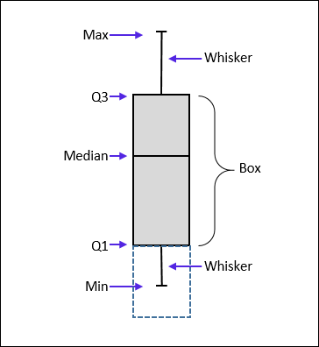
Module 2: Percentile Scores
Each of the four quartile groups a population can be divided
Quartiles
Measures the difference between the third and first quartile
IQR: Inter-quartile range
Note: Must be ordered in lowest to highest value
Used to study the composition of a data set and examine the distribution
Box Plot

Slide 8
Module 2: Rules of Probability
There are six toll booths to enter the highway. What probability does each toll booth worker have of getting the next customer?
1 customer and 6 booths = 1/6 or 16.7%
The order you pick you sample in does not matter
Combination
Picking employees for a shift. Order doesn’t matter.
When given P(A) given P(B), you can use this to find the P(B) given P(A)
Bayes Theorem
You must know P(A), P(B), P(A) given B
Apply this rule when looking for two events occurring (AND)
Multiplication
Use this rule when looking for one or the other event happening (OR)
Addition

Slide 9
Module 3: Statistical Test
A technique for minimize total cost or maximize profit based on constraints
Linear programming
A technique using a single independent variable to predict a single dependent variable
Linear regression
A technique using more than one independent variable to predict a single dependent variable
Multiple regression
Measures the strength of a linear relationship
Correlation coefficient
Measures the goodness of fit in a regression analysis
R² (R-Square)

Slide 10
Time Series
A simple regression using time as the independent variable
Time series
A general slope upward or downward over a period of time
Trend
Unforeseen circumstances causing random deviations
Irregularity
Repetition in up and down patterns
Cyclicality
Regular pattern within a single year
Seasonality

Slide 11
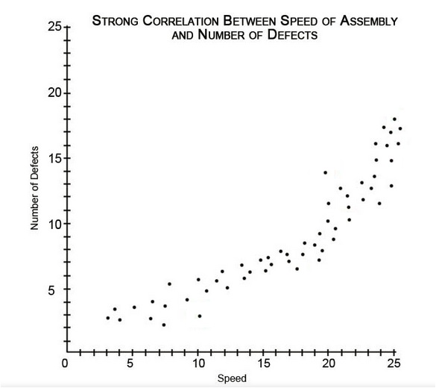
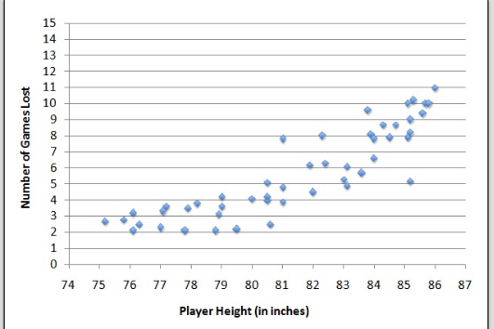
Scatterplots and Correlation
Negative
Positive
Weak (Dots are spread apart)
Strong (Dots are close together)

Slide 12
Module 2: Distributions and confidence levels
Represents the probability that a variable falls with a certain range
Cumulative distribution
A list of all the different probabilities of each outcome that can occur
Probability Distribution
Measures of central tendency are approximately equal (Mean and Median)
Normal Distribution

Slide 13
Module 3: Analysis Techniques
Used to compare the mean of three or more groups
ANOVA
ANOVA uses this test statistics
F-value
(must be higher than critical value to reject the null)
T-test uses this test statistic
T-value
(must be higher than critical value to reject the null)
A correlation is weak if the coefficient is close to ____
Zero
A correlation is strong if the coefficient is close to ____
1 or -1

Slide 14
Module 4: Seven Basic Quality Tools
Illustrates performance measurements over a period of time
Run Chart
Illustrates limits or constraints a process should not exceed
Control Chart
Assists in brainstorming issues that are causing a problem
Cause and Effect Diagram
Not measurements!
Visual tool to understand a process
Flowchart
Easy tool to collect data to create other charts
Check Sheet

Slide 15
Module 4: Seven Basic Quality Tools
Graphical display of a data set with one bar for each category
Histogram and Pareto
Graphical display of data set centered
Histogram
Graphical display of data set in highest to lowest order
Pareto
Used for potential relationships and correlation between variables
Scatter diagram
Can the seven tools be used independently?
Yes

Slide 16
Module 4: Seven Basic Quality Tools
What percent of quality problems does Ishikawa claim the seven tools can solve?
90% - 95%
Diagram demonstrating all of the elements that can influence a process before it starts.
SIPOC (Supplier – Input – Process – Output – Customer)
Manufacturing approach to improving processes.
Six Sigma
In manufacturing, statistics is used for:
Quality Control
Plan - Do – Study – Act
Which step is a response to analytical results?
Act

Slide 17
Module 4: Seven Basic Quality Tools
Shows whether a result meets a requirement or not
Attribute
Shows how well a result meets the requirement
Variable
Variations accepted as the normal part of the process
Common cause variation
Variation from an abnormality causing large discrepancy in results
Special cause variation

Slide 18
Module 5: Test Construction & RBM
Model of designing, analyzing, and scoring tests
IRT: Item Response Theory
How does the government differ than private sector cost-benefit analysis?
Government benefits aren’t always money. Could be flood prevention or welfare.
Compares one individual’s performance to other individuals
Norm Referenced
Compare individual’s performance to a standard score (Example: Cut Score 64%)
Criterion referenced
Management strategy that uses results as the central measurement of performance
RBM: Results Based Management

Slide 19
Module 5: Big Data & Health Care Performance Measures
What is Big Data?
Very large data sets
Used to count ALL of the existing cases in a disease.
Prevalence
Used to count only the NEW cases of a disease.
Incidence (Incident rate)
Compare individual’s performance to a standard score (Example: Cut Score 64%)
Criterion referenced
Used to analyze if funding is worth the outcome of a project
Cost-benefit analysis

Slide 20
Module 6: Performance Measures
Performance measure for one specific goal
KPI – Key performance indicator
Multiple KPIs are displayed for the big picture
KPI dashboard
More than one chart is needed
What does a balanced scorecard measure?
CLIF – (customer, learning, internal process, financial performance) Are we meeting the strategy?
Advantage or Disadvantage of balanced score card? Requires time and effort to establish a meaningful scorecard
Disadvantage
Advantage or Disadvantage of balanced score card? Improves Internal and External Communication
Advantage

Slide 21
Module 6: Performance Measures Advantage or Disadvantage
Balanced Scorecard: Difficult to maintain momentum
Disadvantage
Balanced Scorecard: Improves organizational alignment
Advantage
Balanced Scorecard: Links strategy to organizational results
Advantage
KPI: Data driven results make it easier to quantify performance
Advantage
KPI: Difficult to change once set up
Disadvantage

